Slide 1

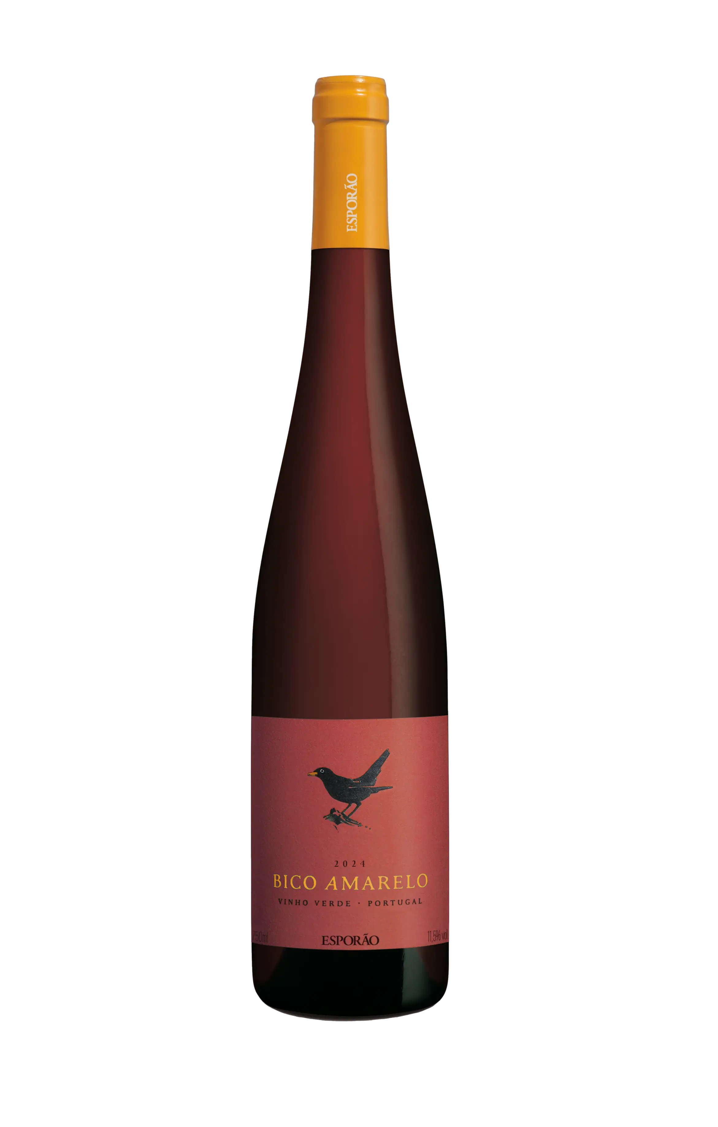
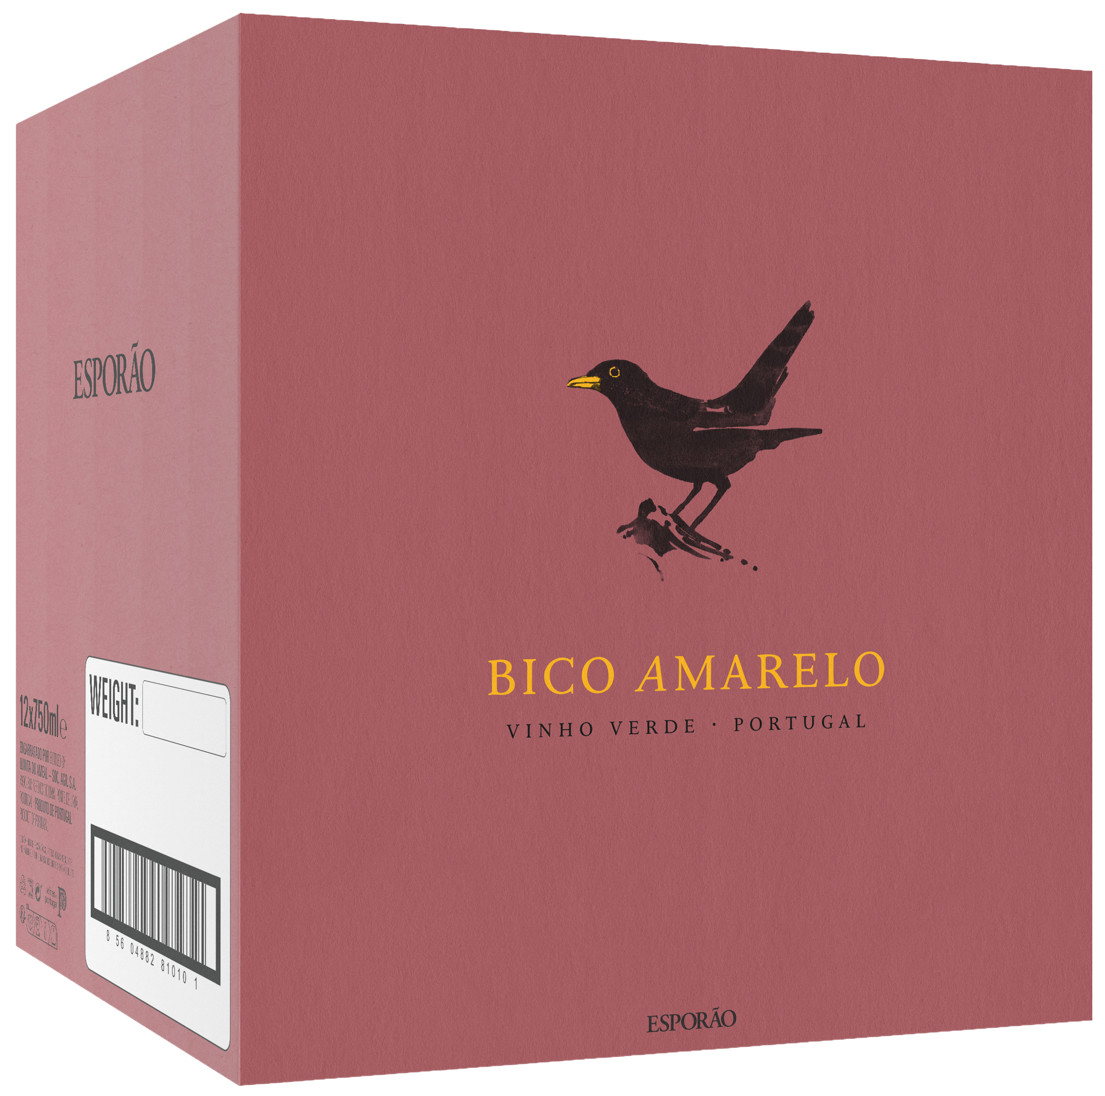

INTRODUCING
Region
Vinho Verde
2025 BICO AMARELO RED
This summer, embrace a ‘rare bird from Vinho Verde’: Bico Amarelo Red by Esporão. This fresh, bright, red is made from indigenous northern Portuguese varieties from around the Vinho Verde region.
Vinho Verde wines have been exported since the 17th century, but over the course of those 400 years, only the tiniest fraction of those exports have been red. Considering that 40% of production in the DOC is red wine—and that it’s consumed almost 100% locally—this may well be Portugal’s best-kept secret.
Bico Amarelo Red is a dry, 100% unoaked blend of Espadeiro, Padeiro, & Borraçal with no added CO2.
Thanks to the intensely maritime climate, it takes generational knowledge to grow red grapes in Vinho Verde. This bottling is a blend of 3 of the region’s rare indigenous varieties. Serve with a light chill to enjoy like the locals do!
Bico Amarelo Red is produced in limited quantities
View the full technical sheet and learn more in our Library
Visit the Library
A ‘rare bird’ from Vinho Verde

