Slide 1
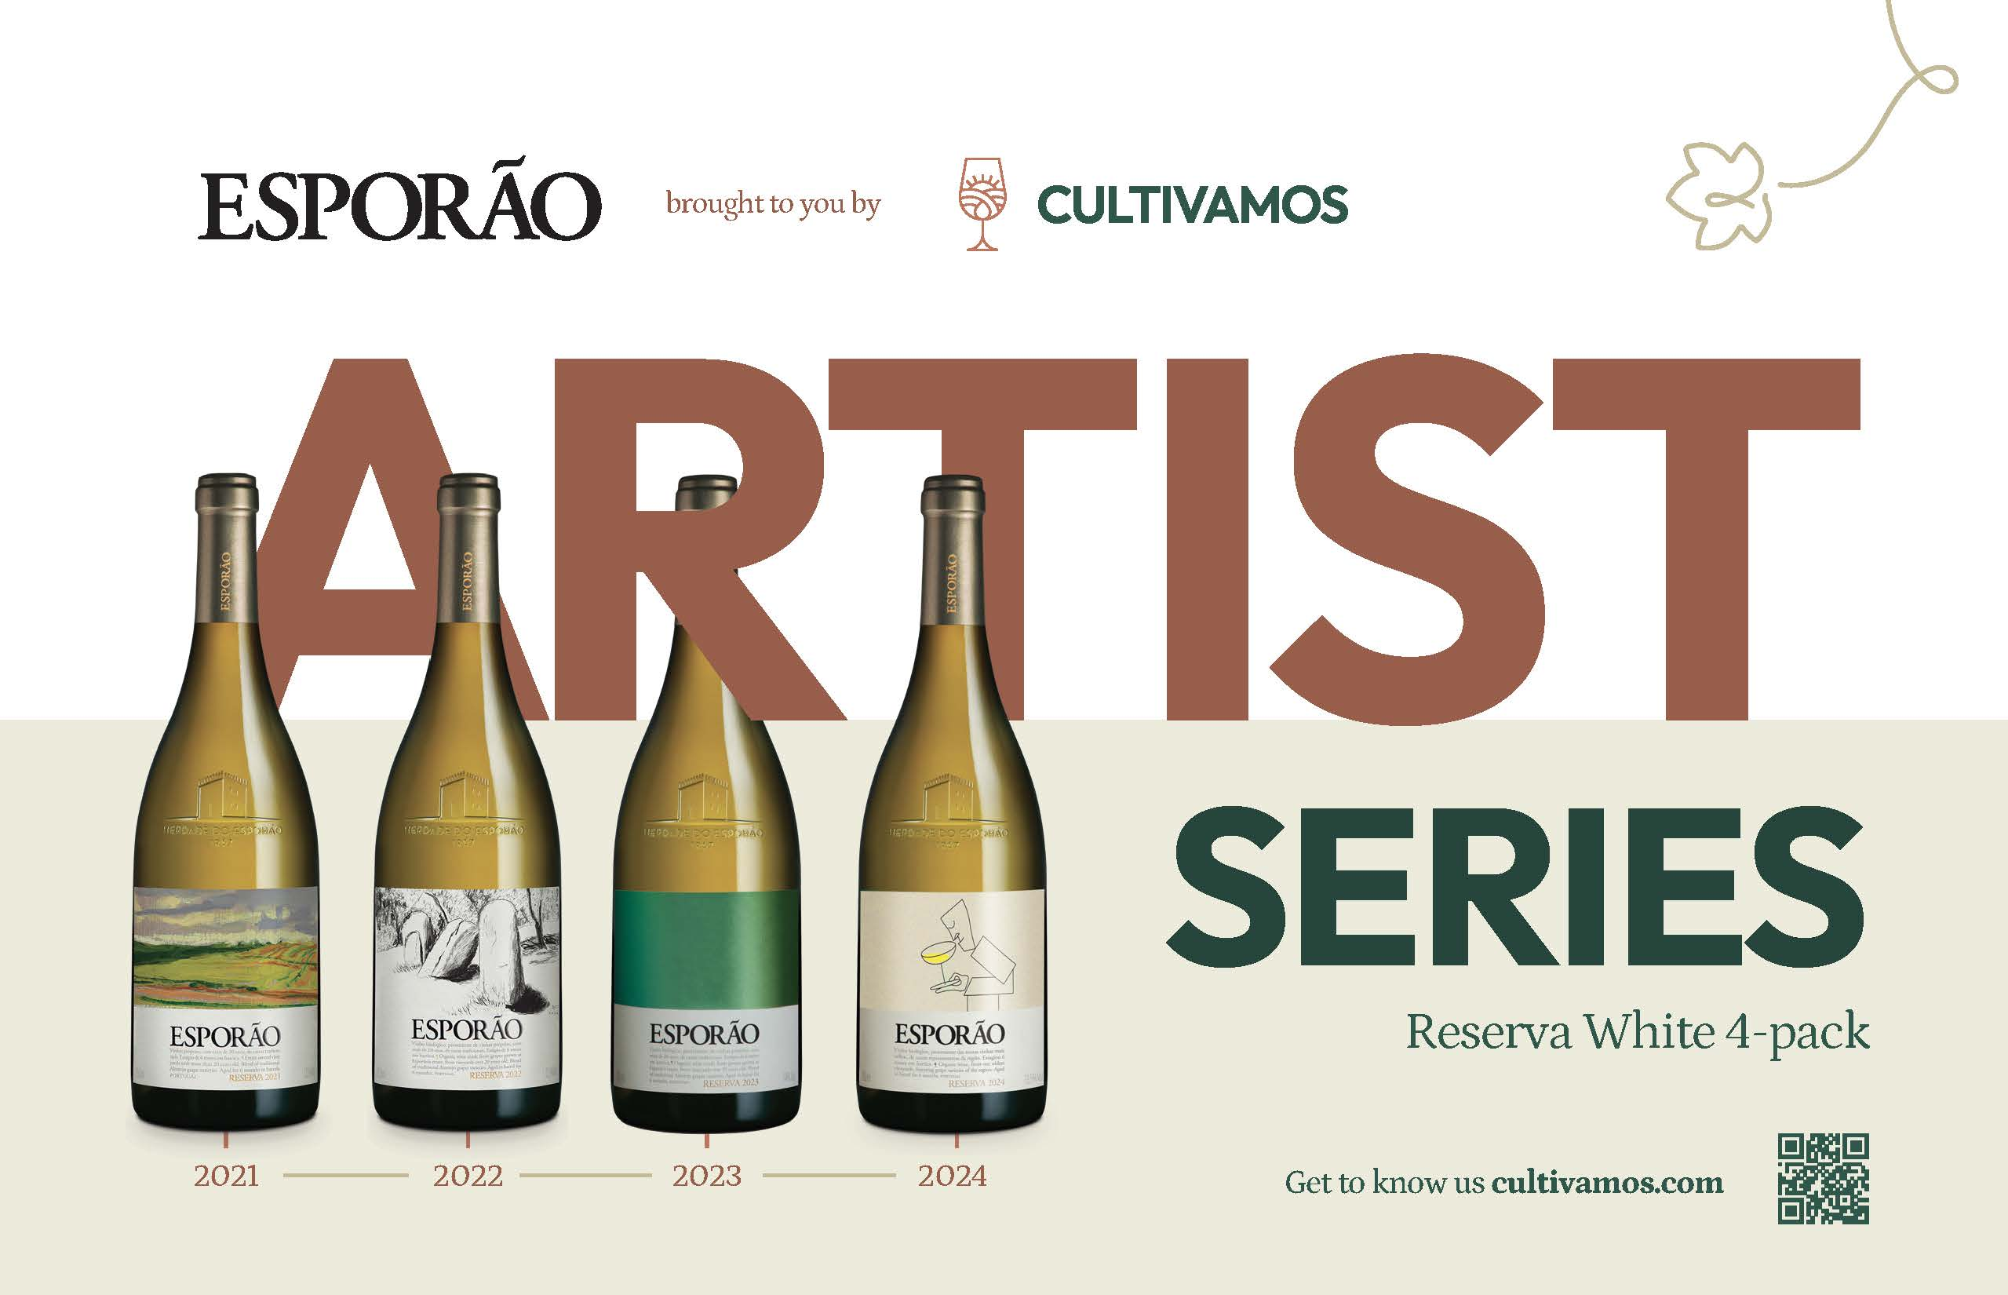

ABOUT THE ARTIST SERIES RESERVA PACK
This first-of-its-kind vertical includes 3 bottles of each vintage, creating a unique opportunity to compare vintages while also cellaring the wines for future exploration of Esporão’s elegant, ageable flagship white. Only sixty cases available.
About the wine
This blend of indigenous Alentejo varieties Antão Vaz, Arinto & Roupeiro expresses the balance between intensity of fruit, fresh acidity, and structure from aging in barrel. It represents the best of the Esporão estate’s vines and soils. A white wine for red wine drinkers.
The groundbreaking Esporão Reserva, established in 1985, is Alentejo’s—and perhaps Portugal’s—first and most iconic fine wine, and continues to serve as the highest expression of place, terroir, art, and artisan craft. These labels feature original artwork from Abel Mota, Alexandre Conefrey, Eduardo Aires and Álvaro Siza Vieira.
Visit the Library for trade tools and additional offerings

