Slide 1
Take Root | September 14, 2026

Slide 2


The team
Ben Carson-Brown
President & CEO
Rui Abecassis
Director of Business Development, Wines & Olive Oil
David Kemmerer
Director: Key Accounts & US Distribution
Joana Santos
Olive Oil Commercial Manager
José Barreto
Director of Olive Oil Sales and Marketing

Slide 3
Portugal: Home of Esporão

Slide 4
ESTABLISHED IN 1973
WINE
OLIVE OIL
TOURISM

Slide 5

OUR HISTORY
1267 –Esporão Estate was established
1973 - Esporão begins the journey to become one of Portugal’s leading wine and olive oil producers.

Slide 6
A REAL PLACE TO VISIT
1000+ year old olive tree, indigenous to the Alentejo region,
located next to the Medieval Tower and
close to the Olive Oil Mill

Slide 7
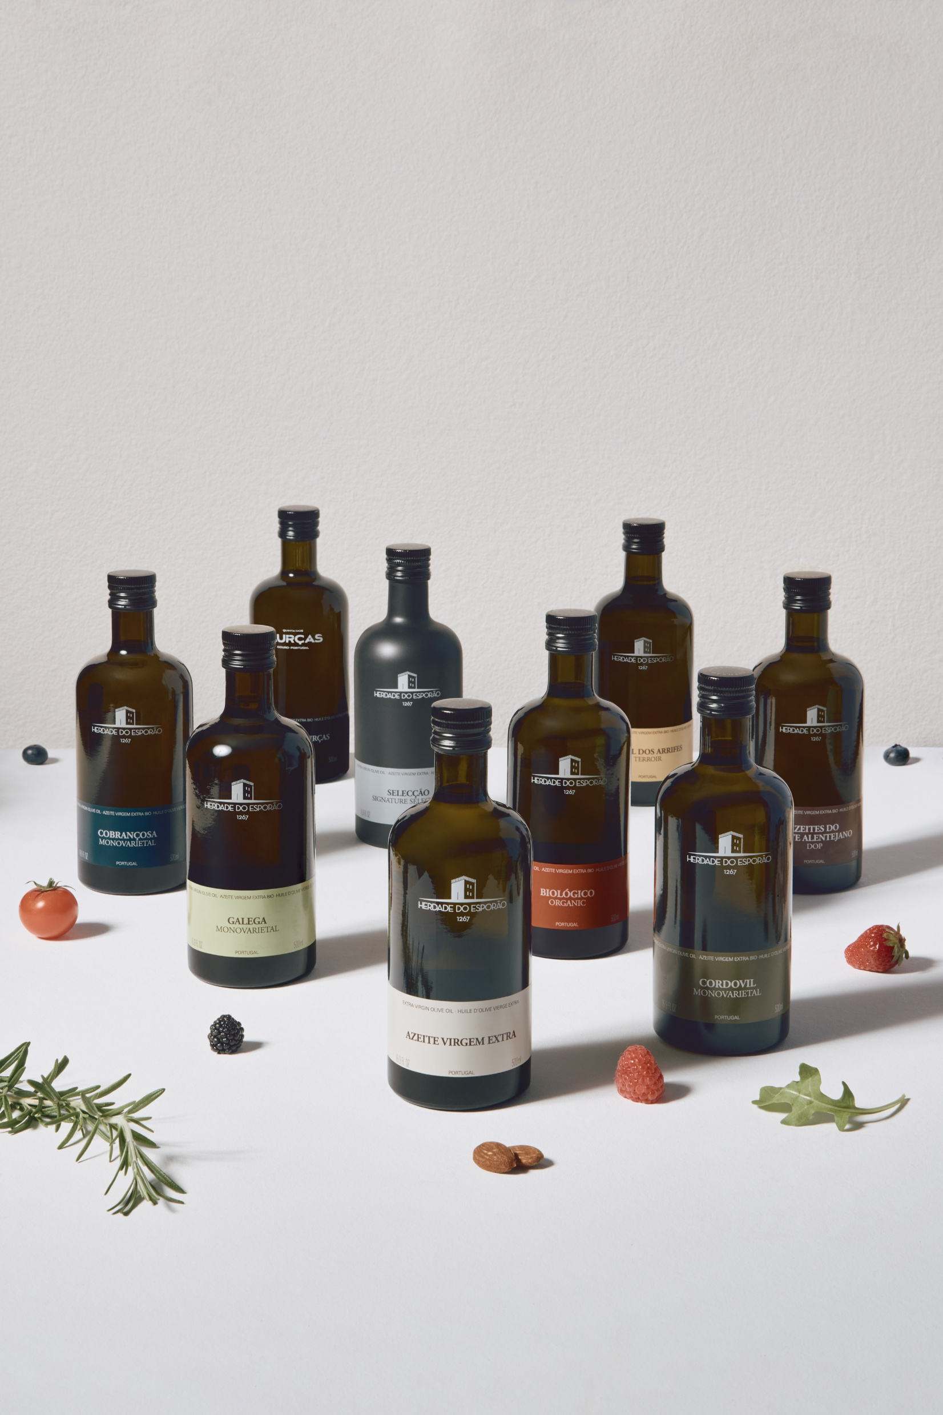
OLIVE OIL | OUR HISTORY
Our olive oil journey began in 1997.
We set out to craft some of Portugal’s finest extra virgin olive oils.
Today, Esporão is the #1 premium extra virgin olive oil brand in Portugal and Brazil.

Slide 8

OUR HISTORY
We source distinctive Alentejo olive varieties from our groves and trusted local growers.
Harvest: 14 varieties from 60 growers.
Ana Gaspar, Head of Olive Oil, who oversees every step of production; leading a team of 12 people.

Slide 9

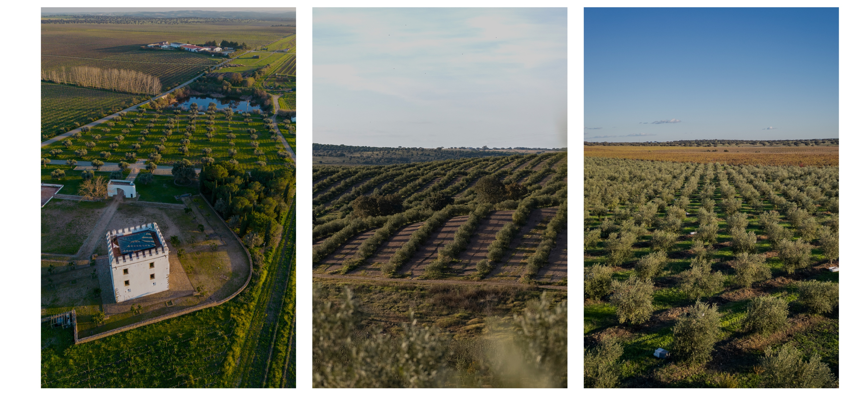
OUR OLIVE GROVES
Certified Organic Farming – 95 ha
TORRE
ARRIFES
CORDOVIL
NEW OLIVE GROVE
200 HA
INDIGENOUS VARIETIES
Notes:
Currently about 100 hectares; expanding to 200 hectares by 2028.

Slide 10
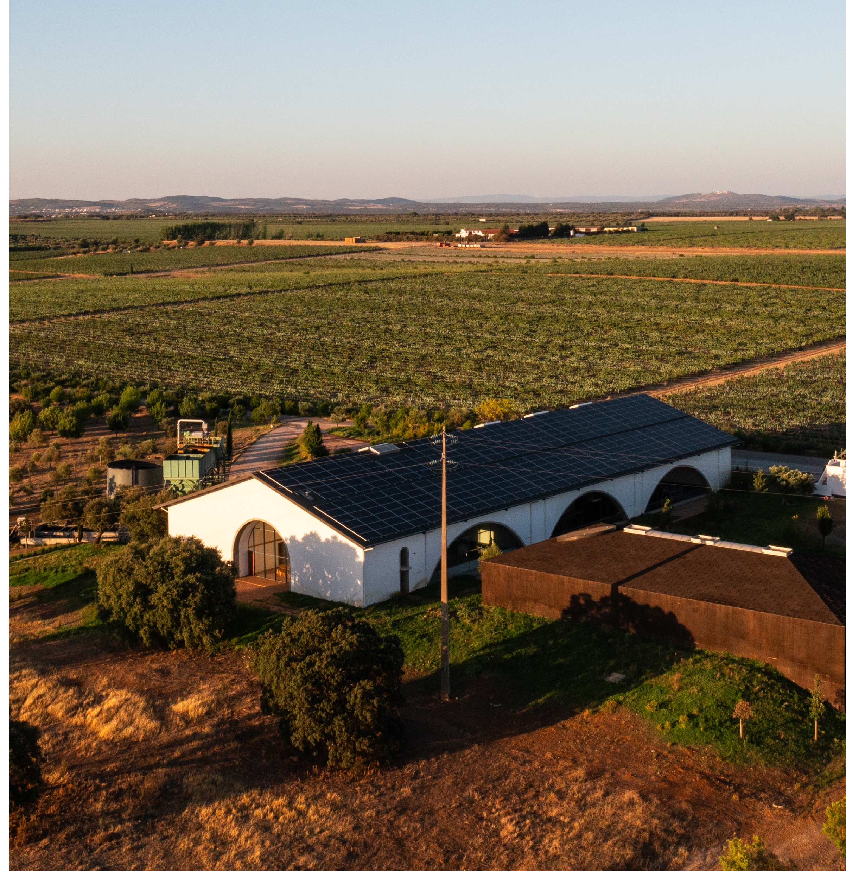
OUR OLIVE MILL
Our estate mill protects quality from harvest to extraction. Its efficient, low-waste process preserves the olives’ nutrients, aromas, and flavors.

Slide 11
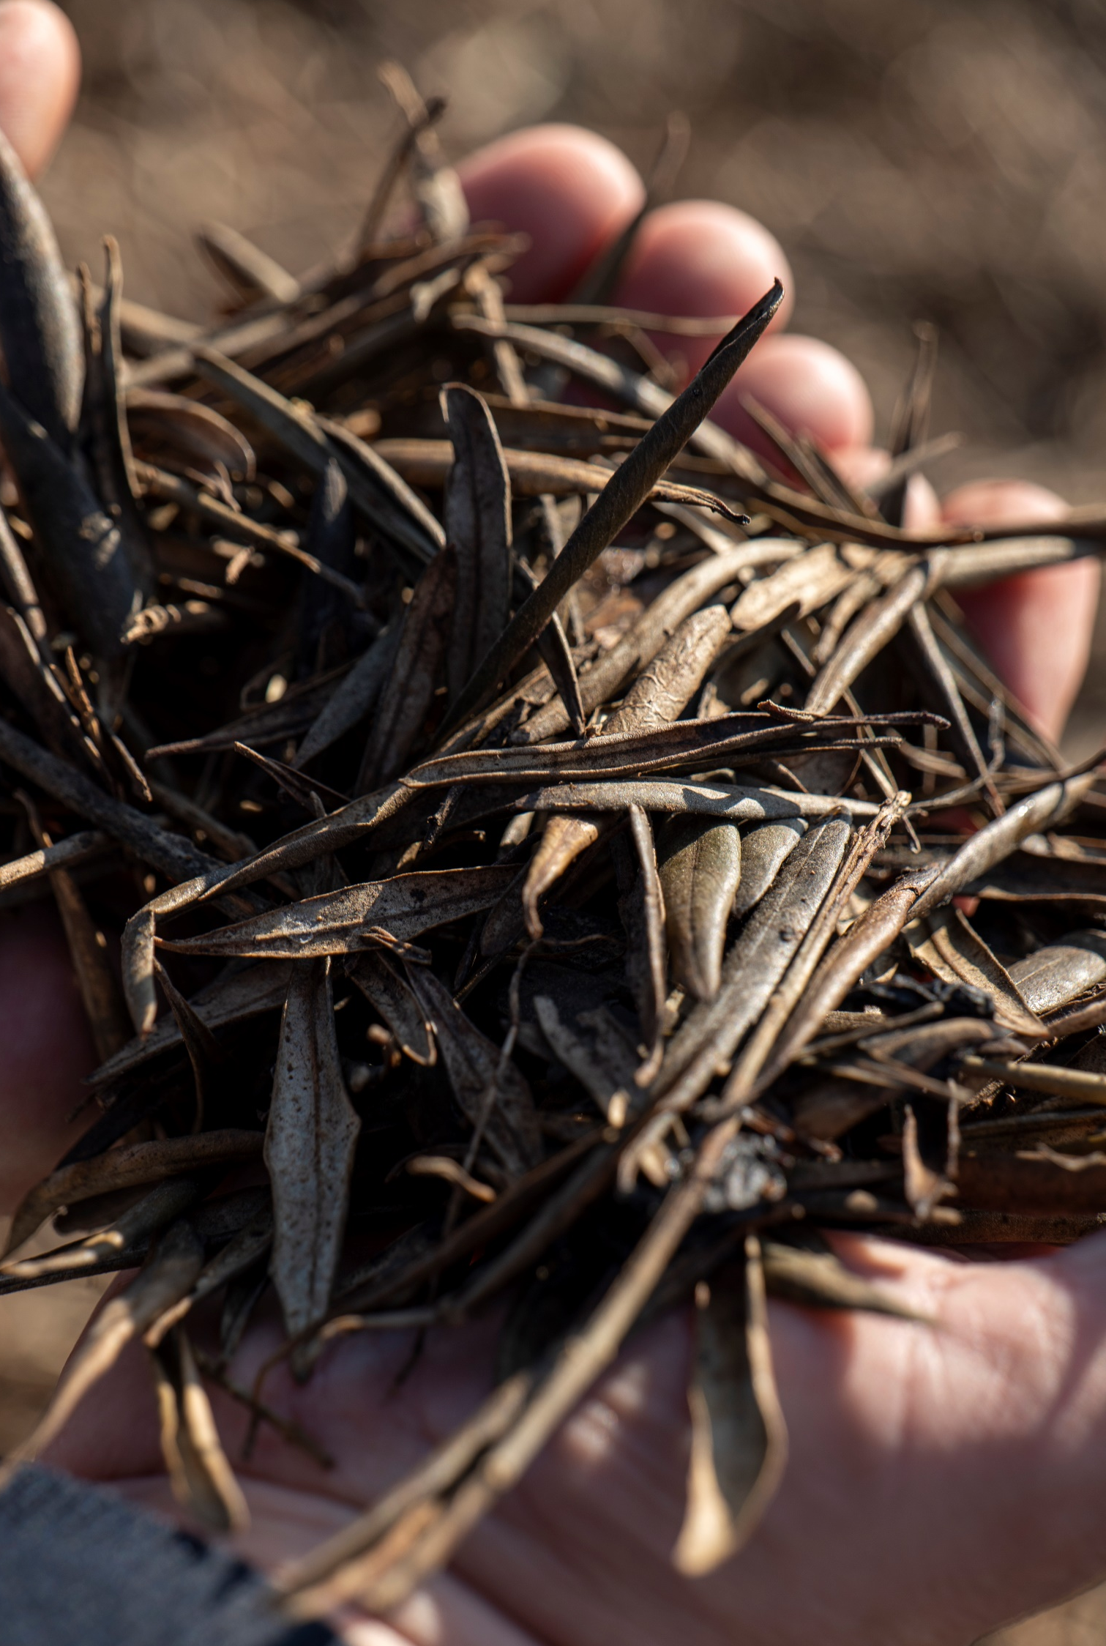

OUR OLIVE MILL – SUSTAINABILITY
COLD EXTRACTION
OLIVE PITS
ZERO WASTE
Add figures if we have it – use sustainability report
People first practices
Innovative technology keeps extraction temperatures
below 27°C (81°F).
Olive pits help generate electricity and heat water across the estate.
102 tons in 2024, saving 43 K liters of diesel, and generating 433.000 kW
Olive pomace is composted and treated on-site; process water is recovered for reuse.
Company-wide data*:
55% of energy consumed derived from own renewable sources
93% of waste recycled
148 hectares of wild habitats restored
*Source: Esporão 2024 Sustainability Report

Slide 12
ESPORÃO OLIVE OILS
ESPORÃO IS UNIQUE
INDIGENOUS PORTUGUESE OLIVE VARIETIES
A PLACE CUSTOMERS CAN EXPERIENCE
FROM GROVE TO BOTTLE
AT OUR ESTATE MILL
QUALITY OVER VOLUME
SUSTAINABLY PRODUCED
Protecting Portugal’s olive-growing heritage.
Esporão grows, harvests, mills, and bottles at Herdade do Esporão.
Cold extraction at the estate.
No commodity sourcing.
Deliberately limited volume.
Uncompromising quality.
Zero-waste approach across production and by-products.
Our estate groves and vineyards are certified organic.
Visit our olive groves and mill year-round.
Esporão brings the credibility of a recognized premium Portuguese wine producer.

Slide 13


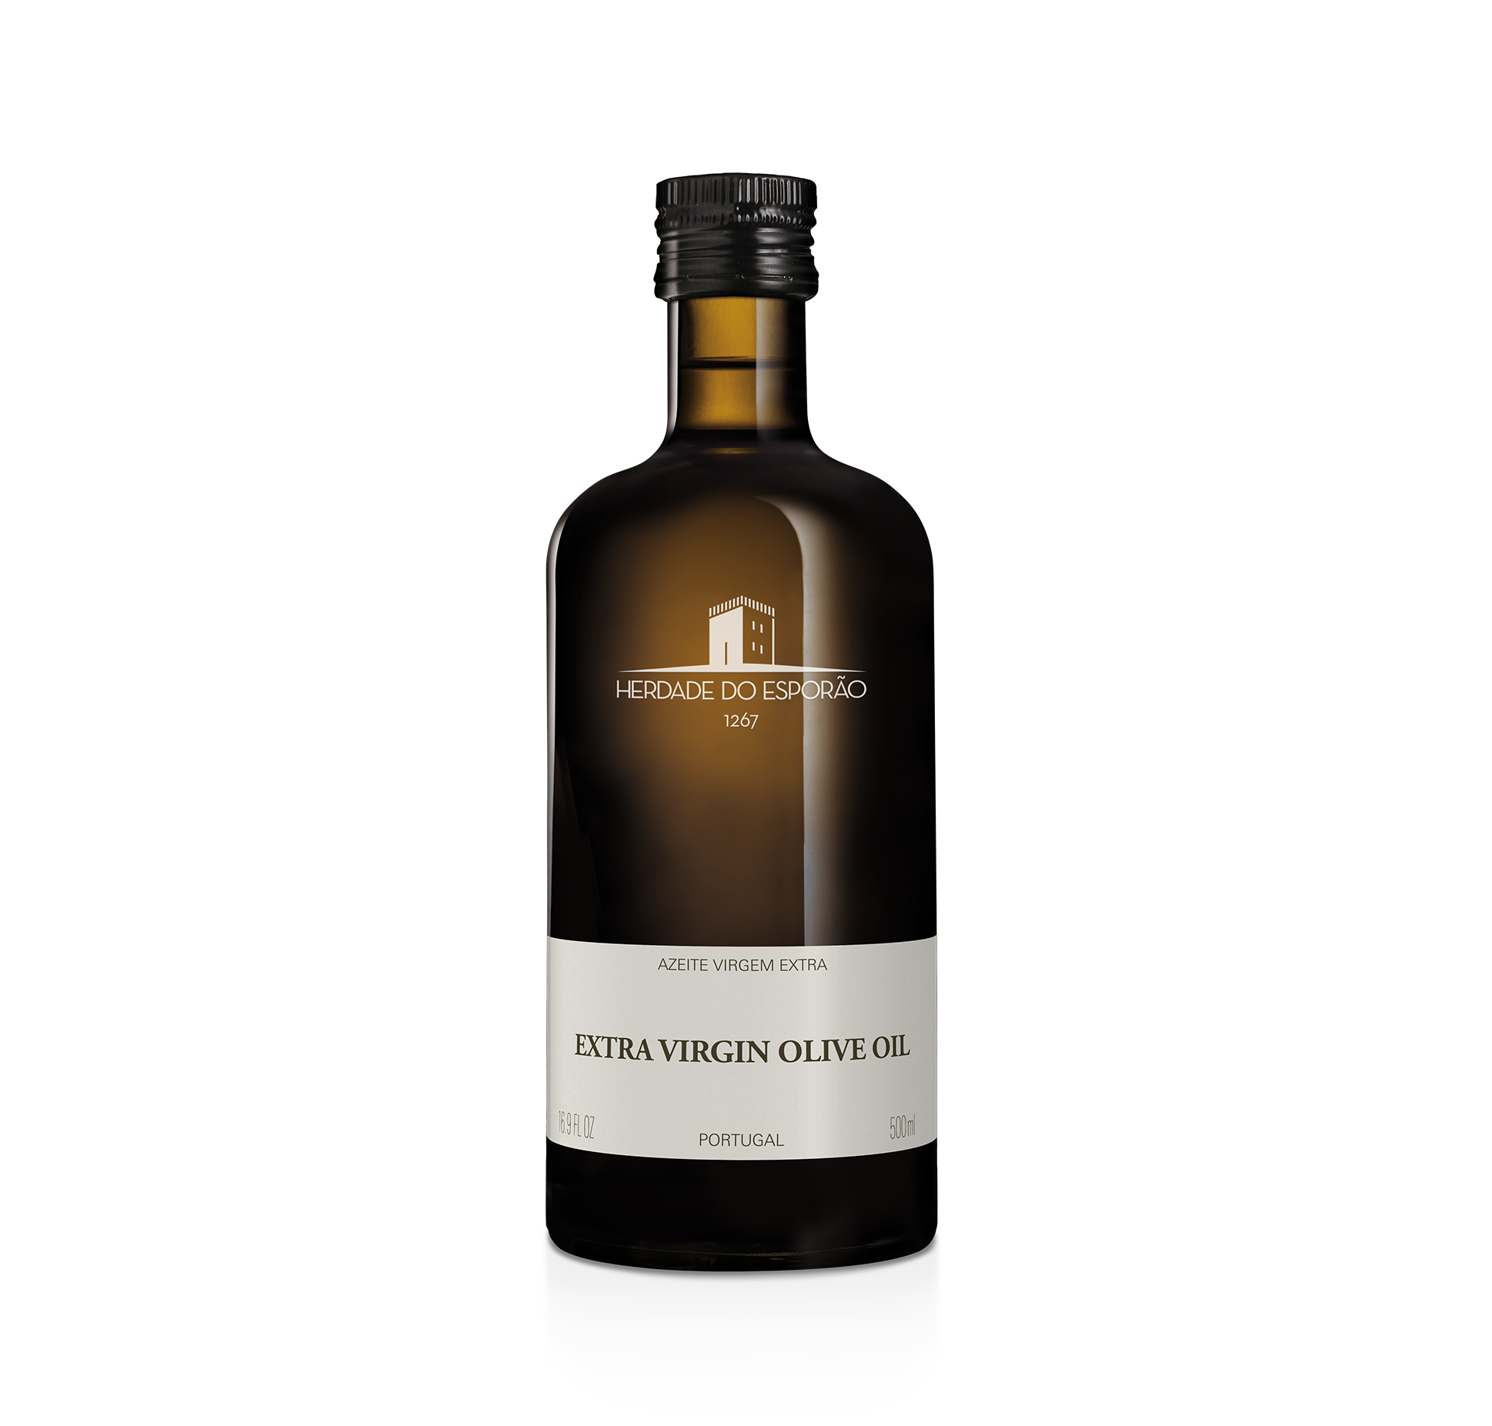
THE OPPORTUNITY
THE U.S. MARKET IS READY
AND PORTUGAL IS COMMITTED
6th-largest EVOO producer worldwide
3rd-largest European EVOO exporter
Yet Portuguese olive oil is still underrepresented on U.S. shelves.
$3.13B U.S. olive oil market — projected to grow at 7.4% CAGR through 2030.
97% import-dependent; retail channel projected at 8.2% CAGR.
Portuguese EVOO remains an open space on shelf.
10–12 million Americans visited Portugal over the past decade and discovered its food culture. Portuguese wine has already built origin awareness in the U.S. — olive oil can follow.
HERDADE DO ESPORÃO OLIVE OIL
Premium, estate-produced brand from Alentejo, southern Portugal
Focused three-SKU core portfolio

Slide 14
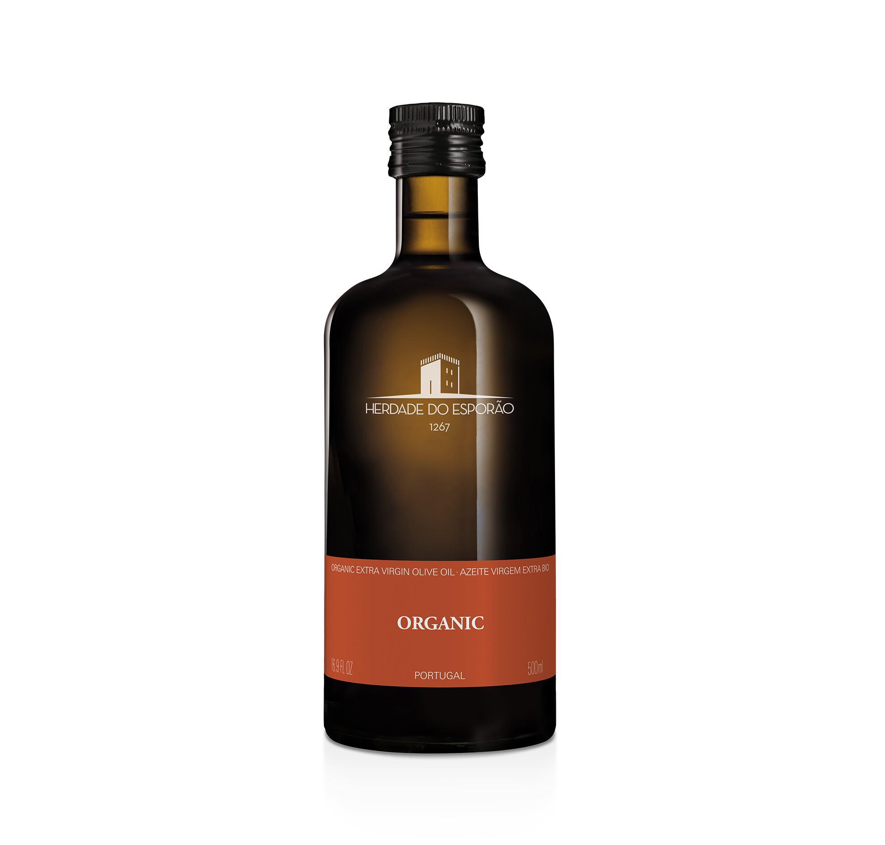
ESPORÃO OLIVE OILS
OUR PORTFOLIO
EVERYDAY
CERTIFIED ORGANIC
SUPER-PREMIUM
CASE:
6/500mL
6/500mL
6/500mL
SRP:
$19.99 - $23.99
$21.99 - $25.99
$25.50 - $29.99

Slide 15
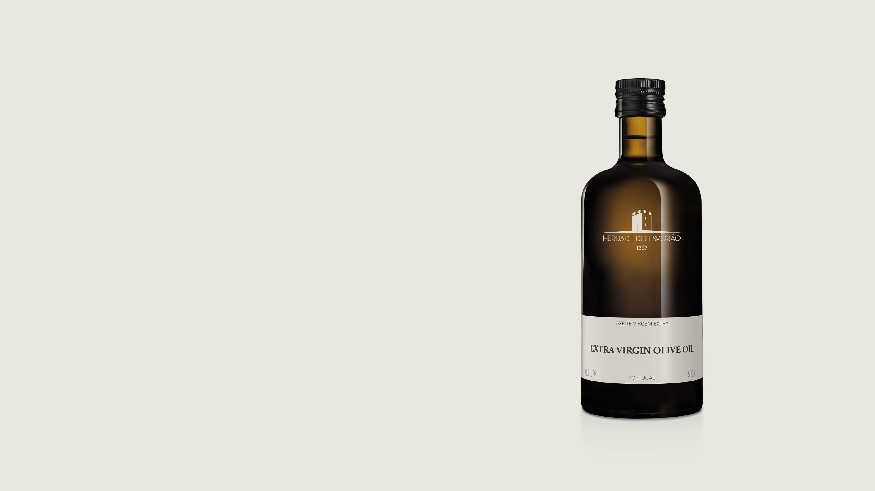


EXTRA VIRGIN OLIVE OIL
Smooth and approachable, with balanced fruit character from Alentejo-grown olives.
INTENSITY
VARIETIES
A regional blend selected at harvest.
AROMA
Fresh fruit, cut grass, and olive leaf.
PALATE
Fresh and gently peppery, with a nutty finish.
PAIRING
A versatile everyday oil for sautéing, frying, baking, and roasting. Also excellent with cheese.
Sizes: 500 mL

Slide 16

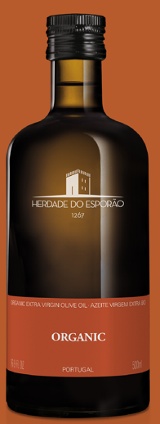

EXTRA VIRGIN OLIVE OIL
ORGANIC
Complex yet balanced, with the bitterness and peppery finish of certified-organic Alentejo olives.
INTENSITY
VARIETIES
AWARDS
Arbequina, Blanqueta, Cobrançosa, Galega and Picual.
NYIOOC
Gold 2025
Olio Nuovo Days
Silver 2024
AROMA
CERTIFIED ORGANIC
Cut grass, green and ripe tomato, banana peel, white flowers, and almond.
PALATE
Elegant and layered, with balanced bitterness and peppery intensity.
PAIRING
Ideal as a finishing oil for salads, risotto, pasta, and plated dishes.
Sizes: 500 mL

Slide 17
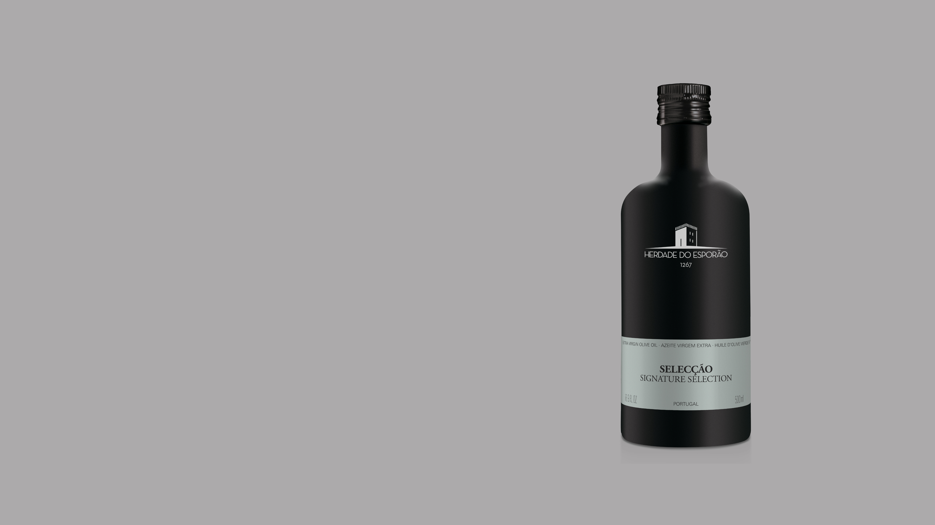
EXTRA VIRGIN OLIVE OIL
SELECÇÃO
Elegant and distinctive, this selection blends herbal and floral notes for discerning olive oil buyers.
INTENSITY
VARIETIES
AWARDS
Arbequina, Azeiteira, Blanqueta, Cobrançosa, Cordovil, Galega, and Picual.
NYIOOC
Silver 2026
Silver 2025
Gold 2024
Olio Nuovo Days
Premium Gold 2024
Olive Japan
Gold 2024
London International Olive Oil Competition
Silver 2024
AROMA
Cabbage leaf, tomato vine, green and ripe tomato, banana peel, and white flowers.
PALATE
Elegant, balanced, and complex, with a smooth entry and green walnut on the finish.
PAIRING
Ideal for vegetables, asparagus, grilled meats, finishing dishes, or dipping bread.
Sizes: 500 mL

Slide 18
VIDEO with 2025/2026 HARVEST

Slide 19

QUESTIONS?

Slide 20
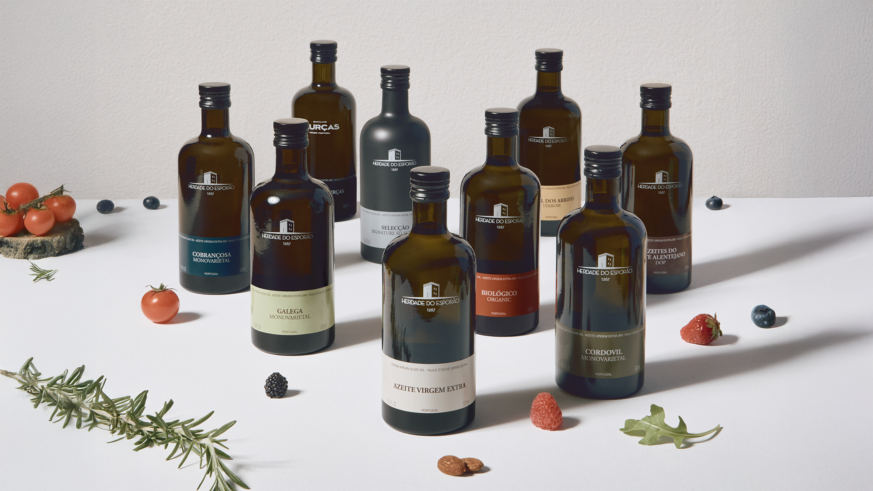
THANK YOU
esporao.com @esporaoazeite @esporaoworld #istoeesporao

Slide 21



HOW OLIVE OIL IS MADE
AT ESPORÃO
1
2
3
HARVEST
MILL
INTAKE
CLEANING
Harvest runs from October through December. Esporão typically harvests several weeks earlier than most European producers.
Branches, leaves,
and field debris
are removed.
Olives are sorted by variety, ripeness, and farming method.

Slide 22
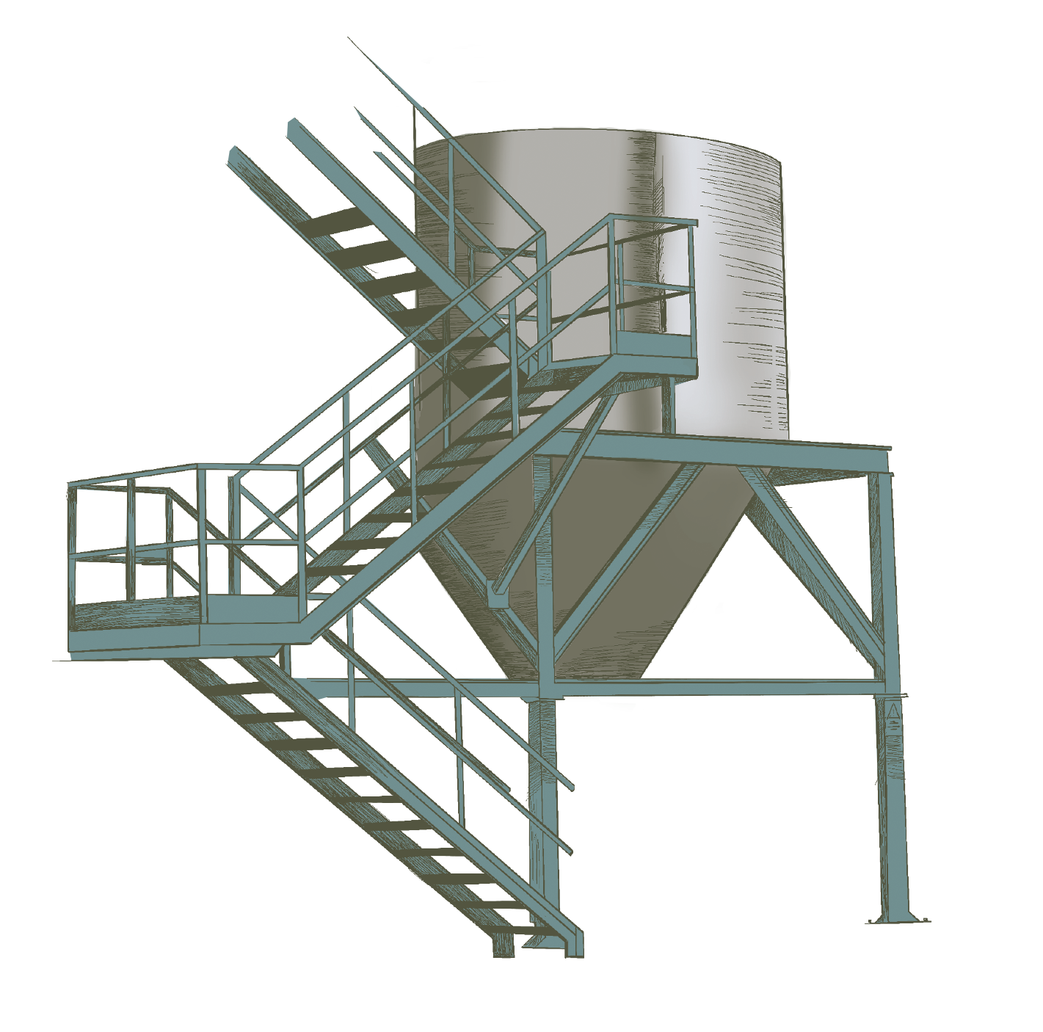
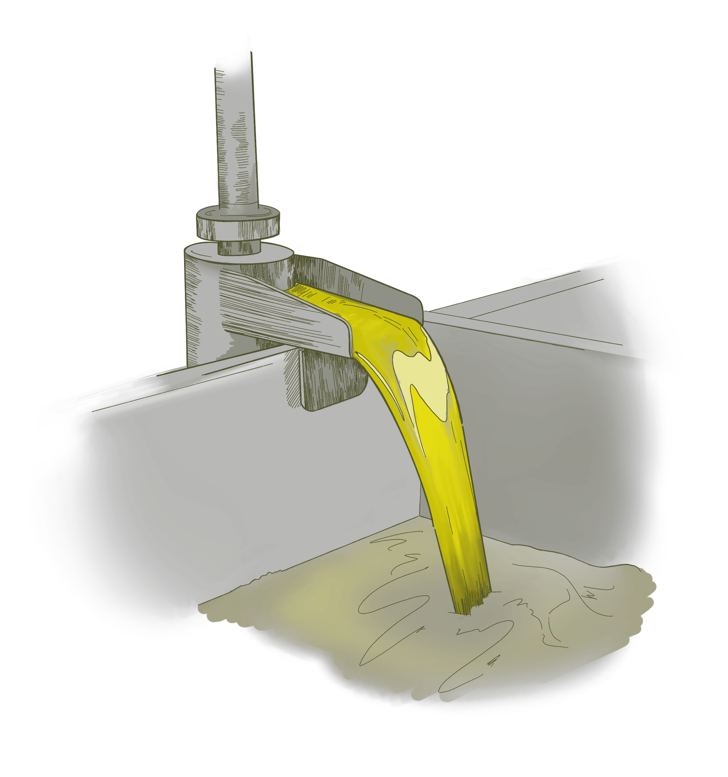
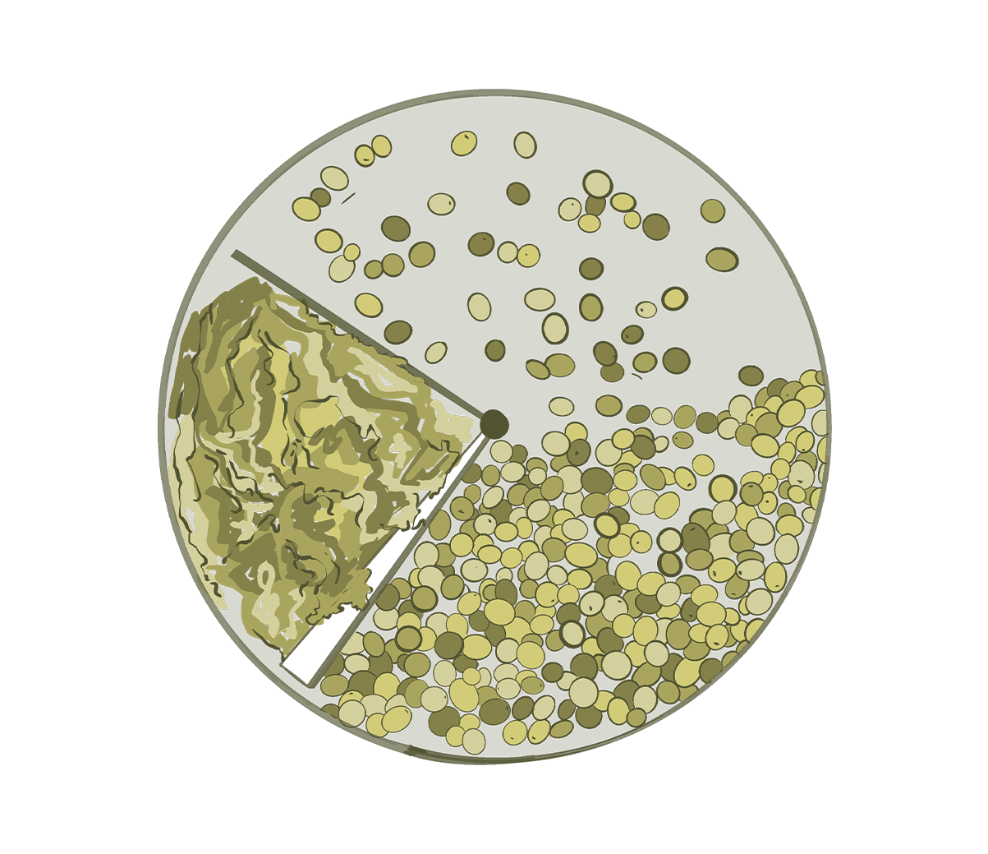
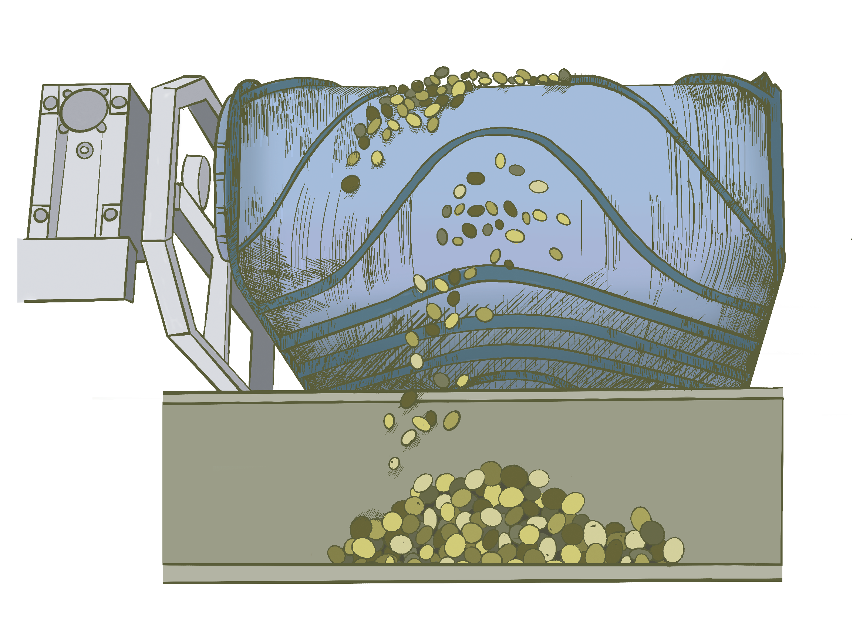
HOW OLIVE OIL IS MADE AT ESPORÃO
4
5
6
7
SCALE
HOPPER
GRINDER
CENTRIFUGE
Cleaned olives are weighed to track each batch before processing.
The hopper stages cleaned olives and keeps each lot ready for milling.
Olives are ground in a conical mill to create a uniform paste.
The centrifuge separates solid matter from the liquid olive oil.

Slide 23
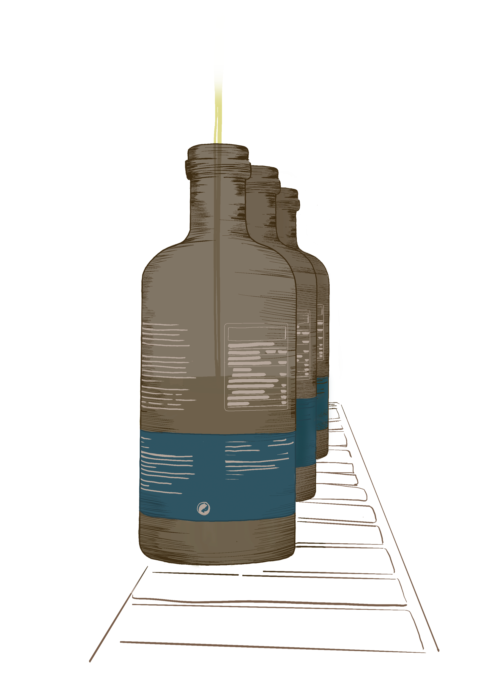
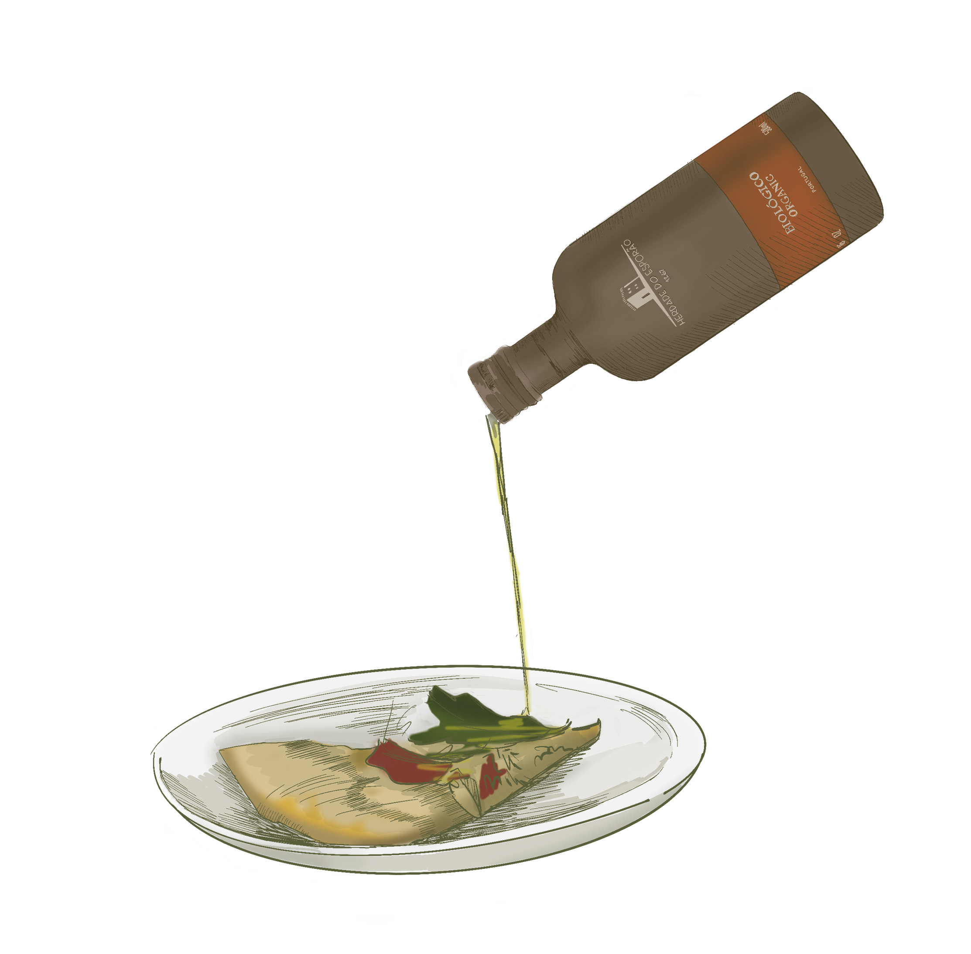
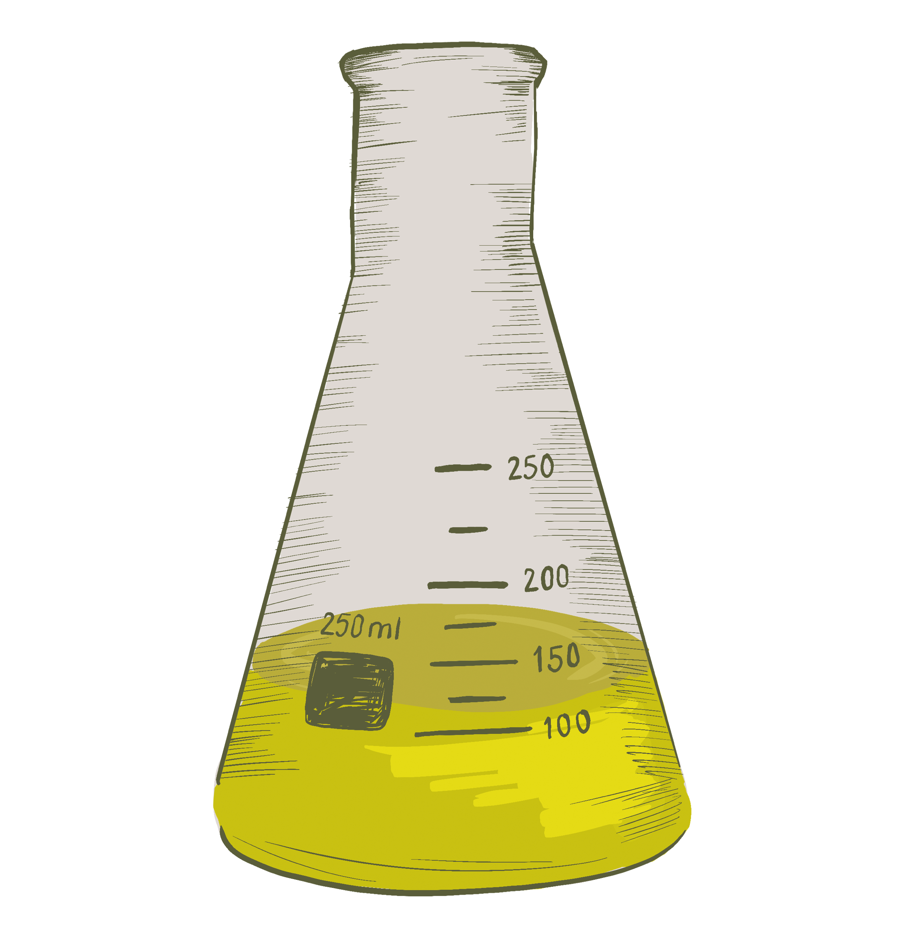
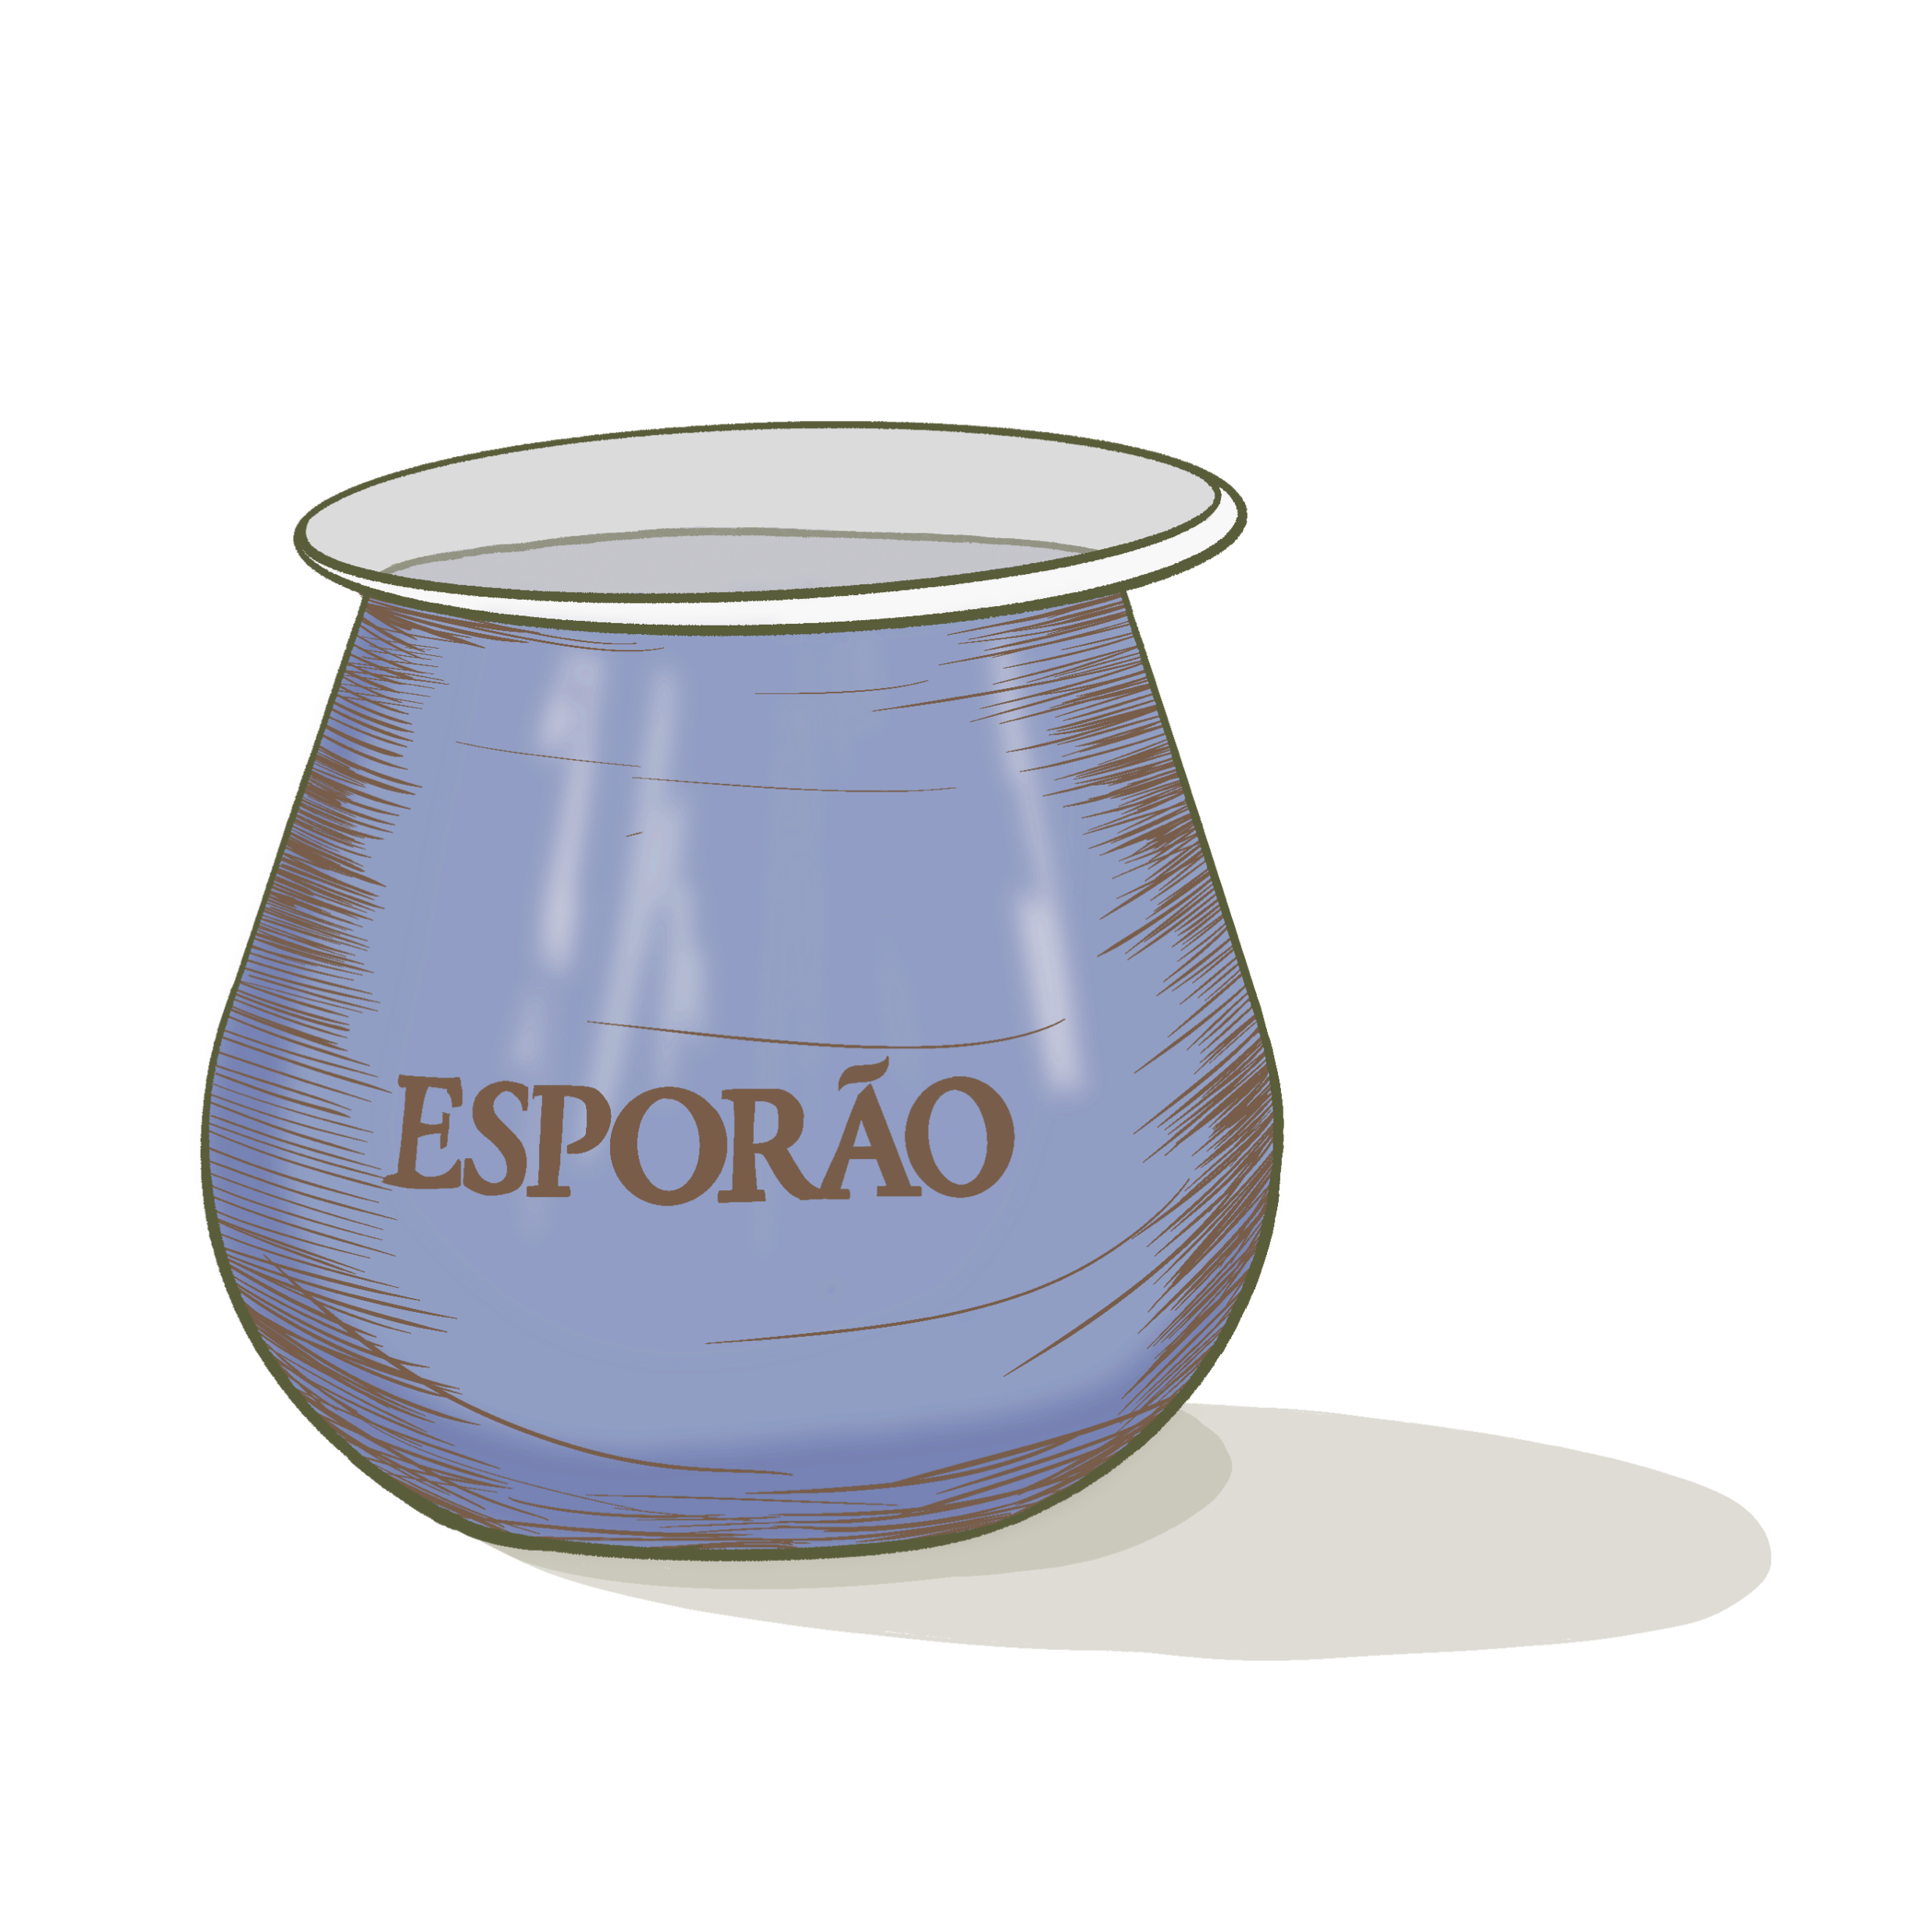
HOW OLIVE OIL IS MADE AT ESPORÃO
8
9
10
QUALITY CONTROL
BOTTLING
TASTE & SHARE
Every batch is tasted twice daily. Our olive oil specialist evaluates flavor, quality, and consistency.
Bottled at the estate in dark glass to protect the oil from light.
Each oil offers a distinct experience—taste the lineup and find your favorite.

Slide 24
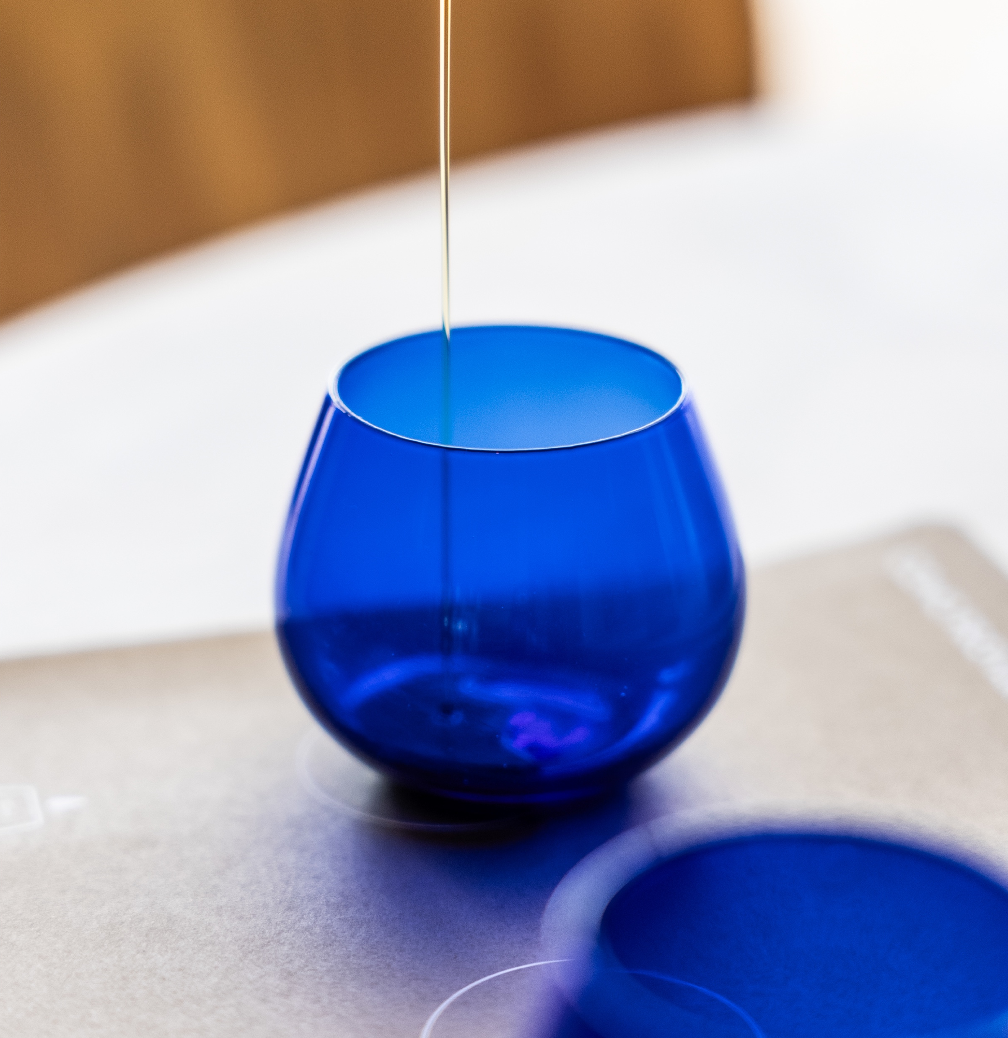
SELLING FACTS
Olive oil is central to Portuguese culture—here are the facts buyers and consumers ask about most.

Slide 25
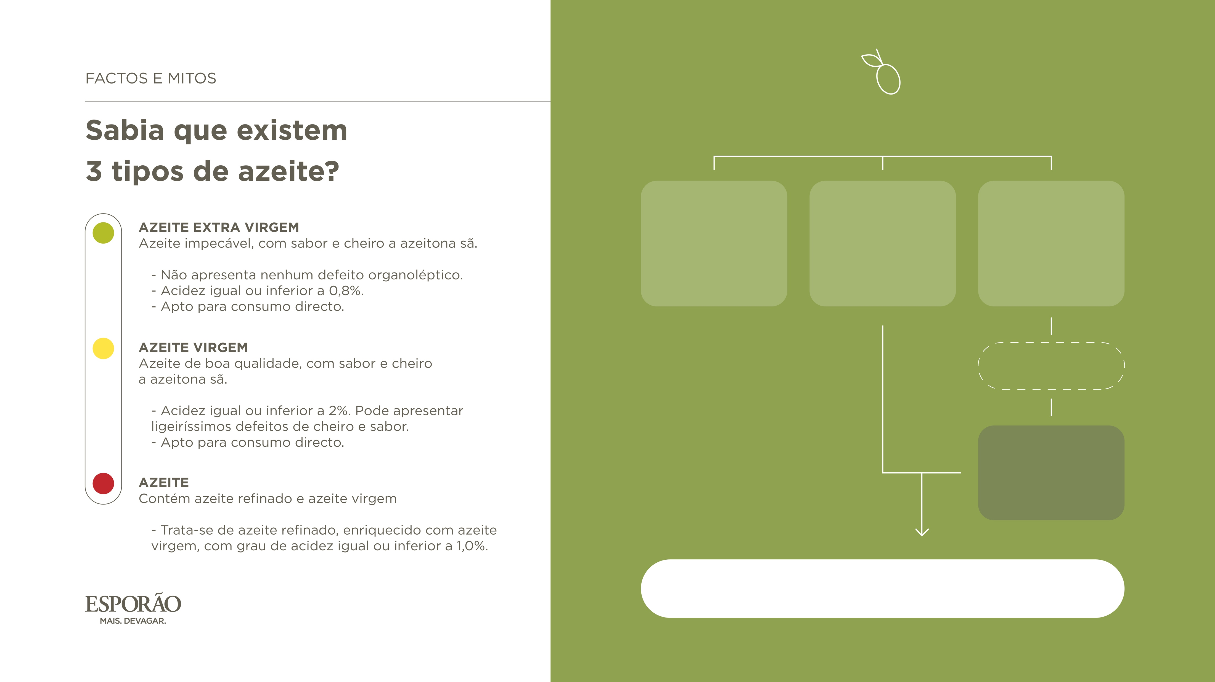
SELLING FACTS
Know the Three Types of Olive Oil
OLIVE
EXTRA VIRGIN OLIVE OIL
VIRGIN OLIVE OIL
LAMPANTE OIL
EXTRA VIRGIN OLIVE OIL
Highest-quality olive oil, with the flavor and aroma of healthy olives.
• No sensory defects.
• Acidity of 0.8% or less.
• Suitable for direct consumption.
VIRGIN OLIVE OIL
Good-quality olive oil, with the flavor and aroma
of healthy olives.
• Acidity of 2% or less; may have
very slight aroma or flavor defects.
• Suitable for direct consumption.
REFINING
REFINED OLIVE OIL
OLIVE OIL
A blend of refined olive oil and virgin olive oil.
• Refined olive oil enriched with virgin olive oil; acidity of 1.0% or less.
OLIVE OIL = REFINED OIL + VIRGIN OLIVE OIL

Slide 26
DID YOU KNOW?
Storage
Harvest
Heat can compromise olive oil quality and diminish its aroma and flavor. Store olive oil in a cool, dark place away from the stove.
Esporão harvests from October through December. The olives move quickly to our mill to preserve freshness and quality.
Color
Acidity
Color is not a measure of olive oil quality. The olive variety and ripeness at harvest determine the oil’s hue.
Acidity is a laboratory measurement—not something you can taste or smell. Unlike the acidity in a lemon or orange, olive oil acidity is not perceptible to the senses.
Cold extraction
We extract below 27°C (81°F) to preserve the oil’s aromas, flavors, and quality.

Slide 27
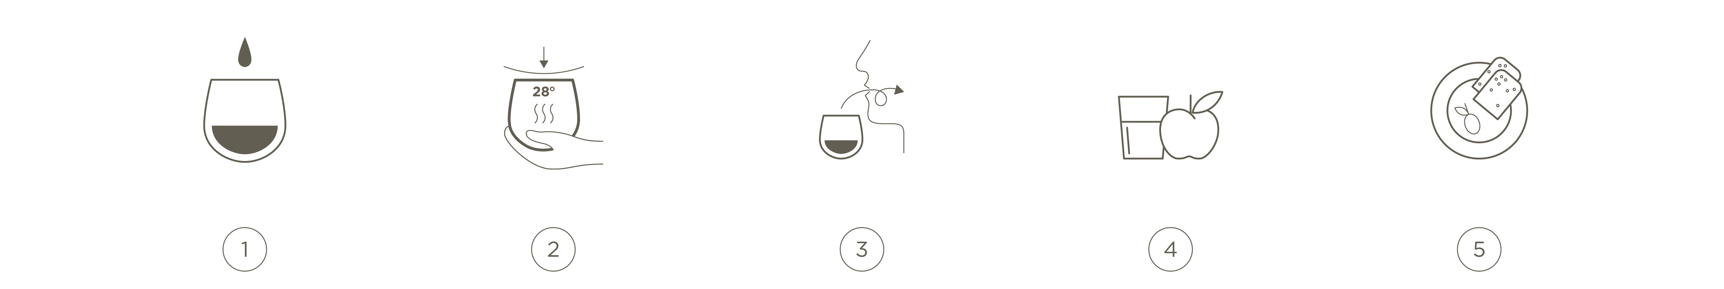
DID YOU KNOW?
How to Taste Olive Oil
Pour about 1 tablespoon (15 mL) into a cobalt-blue tasting glass. The blue glass masks color, which reflects variety and ripeness—not quality.
Cover the glass and warm the oil to about 82°F (28°C) to release its aromas and flavors.
Swirl gently, remove the cover, and inhale slowly. Take a small sip and move the oil around your mouth. Draw in a little air to reveal retronasal aromas, then swallow.
Cleanse your palate between samples with water and a slice of apple.
For a more casual tasting, pair several olive oils with pieces of neutral white bread—a simple, engaging way to start a meal.

